Slide 1

STANLEY COLLEGE OF ENGINEERING AND TECHNOLOGY FOR WOMEN (AUTONOMOUS) Abids. Hyderabad – 500 001 (Affiliated to Osmania University & Approved by AICTE) (All eligible UG Courses are accredited by NBA & Accredited by NAAC with ‘A’ Grade) Department Of Computer Science and Engineering Academic Year: 2025-2026 Mini Project
SMART ADAPTIVE ATTENDANCE INTELLIGENCE SYSTEM (SAAIS)
PROJECT COORDINATOR PRESENTED BY
E.Sreenidhi 160623733144
Mr P. Abhishek Goud M.Puja 160623733160
M.Ujasvi 160623733162

Slide 2
CONTENTS
Abstract
Introduction
Literature Review
Existing System
Problem Statement
Objectives
Proposed System
Architecture
Implementation
Result Analysis
Limitations
Conclusion and Future Scope
Literature Survey
References

Slide 3
ASTRACT
The Smart Adaptive Attendance Intelligence System (SAAIS) is an intelligent attendance management platform designed to automate and secure student attendance monitoring. The system combines dynamic QR code verification, GPS location validation, Wi-Fi authentication, device binding, and contextual media capture to prevent proxy attendance and fraudulent submissions.
The system performs multi-layer verification and calculates a confidence score to classify attendance records as Valid, Suspicious, or Rejected. Faculty members can monitor attendance in real time through a dashboard, while analytics modules provide attendance trends, risk assessment, and student performance insights. The proposed solution improves attendance accuracy, reduces manual effort, and enhances institutional efficiency.

Slide 4
INTRODUCTION
Attendance monitoring is an essential activity in educational institutions. Traditional attendance methods such as paper registers and manual entry consume time and are prone to errors and manipulation.
To overcome these limitations, SAAIS introduces an automated attendance solution that utilizes modern technologies including QR verification, location services, Wi-Fi validation, and intelligent analytics.
The system ensures that attendance is recorded only when students are physically present in the classroom environment, thereby improving reliability and transparency.

Slide 5
LITERATURE REVIEW
S.No | Research Area | Key Findings | Limitations
1 | QR Based Attendance Systems | Faster attendance recording | Vulnerable to QR sharing
2 | GPS Attendance Systems | Verifies location | GPS spoofing possible
3 | RFID Attendance Systems | Quick identification | Requires additional hardware
4 | Facial Recognition Systems | High security | Privacy concerns and cost
5 | Smart Attendance Analytics | Generates attendance insights | Limited verification mechanisms

Slide 6
PROBLEM STATMENT
Educational institutions face challenges in ensuring accurate attendance records due to proxy attendance, unauthorized access, and manual record management.
Existing solutions fail to verify actual student presence effectively and provide limited analytical insights.
A secure and intelligent attendance system is required that can validate student identity, location, device authenticity, and attendance behavior while providing real-time monitoring and analytics.

Slide 7
OBJECTIVES
Primary Objectives
Automate attendance recording
Eliminate proxy attendance
Verify physical classroom presence
Provide real-time attendance tracking
Generate attendance analytics
Secondary Objectives
Improve faculty productivity
Reduce manual effort
Detect suspicious attendance attempts
Generate attendance reports automatically

Slide 8

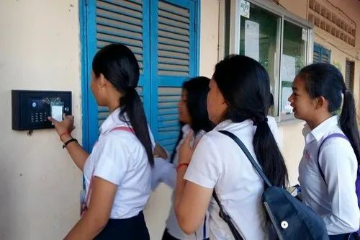
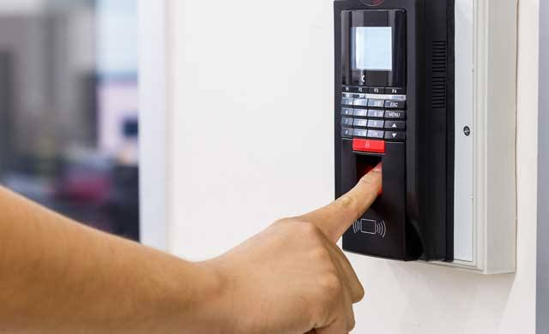
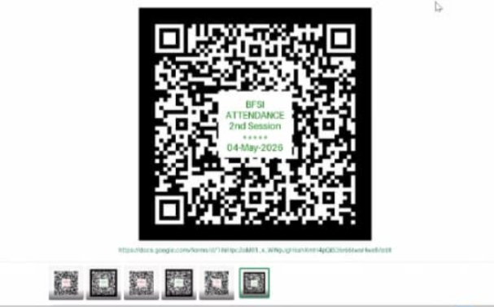
EXISTING SYSTEM
Current attendance systems generally use:
Manual attendance registers
RFID cards
Biometric scanners
Basic QR attendance applications
Drawbacks
Proxy attendance
Manual errors
Time-consuming process
Lack of real-time monitoring
Limited attendance analytics
No multi-layer validation

Slide 9
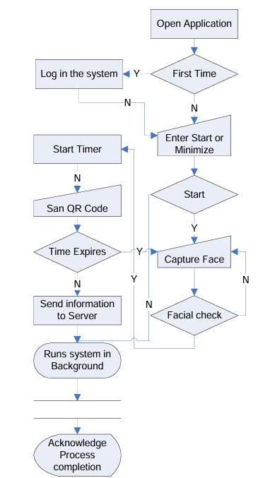
EXISTING SYSTEM - ARCHITECTURE
Existing System – QR Code Based Attendance System
This research paper proposes a smartphone-based attendance system that uses QR codes for automated attendance recording. Students scan a QR code displayed by the instructor, and the system verifies attendance using facial recognition and location validation. The approach reduces manual attendance time, improves efficiency, and helps prevent proxy attendance in educational institutions.
Reference: F. Masalha and N. Hirzallah, "A Students Attendance System Using QR Code," International Journal of Advanced Computer Science and Applications (IJACSA), Vol. 5, No. 3, 2014.

Slide 10
PROPOSED SYSTEM
The proposed Smart Adaptive Attendance Intelligence System combines multiple verification mechanisms:
Features
Dynamic QR Code Verification
GPS Location Validation
Wi-Fi BSSID Verification
Device Binding Authentication
Context Capture (Photo/Video)
Confidence Score Calculation
Faculty Dashboard
Attendance Analytics Engine
This integrated approach ensures secure and reliable attendance recording

Slide 11
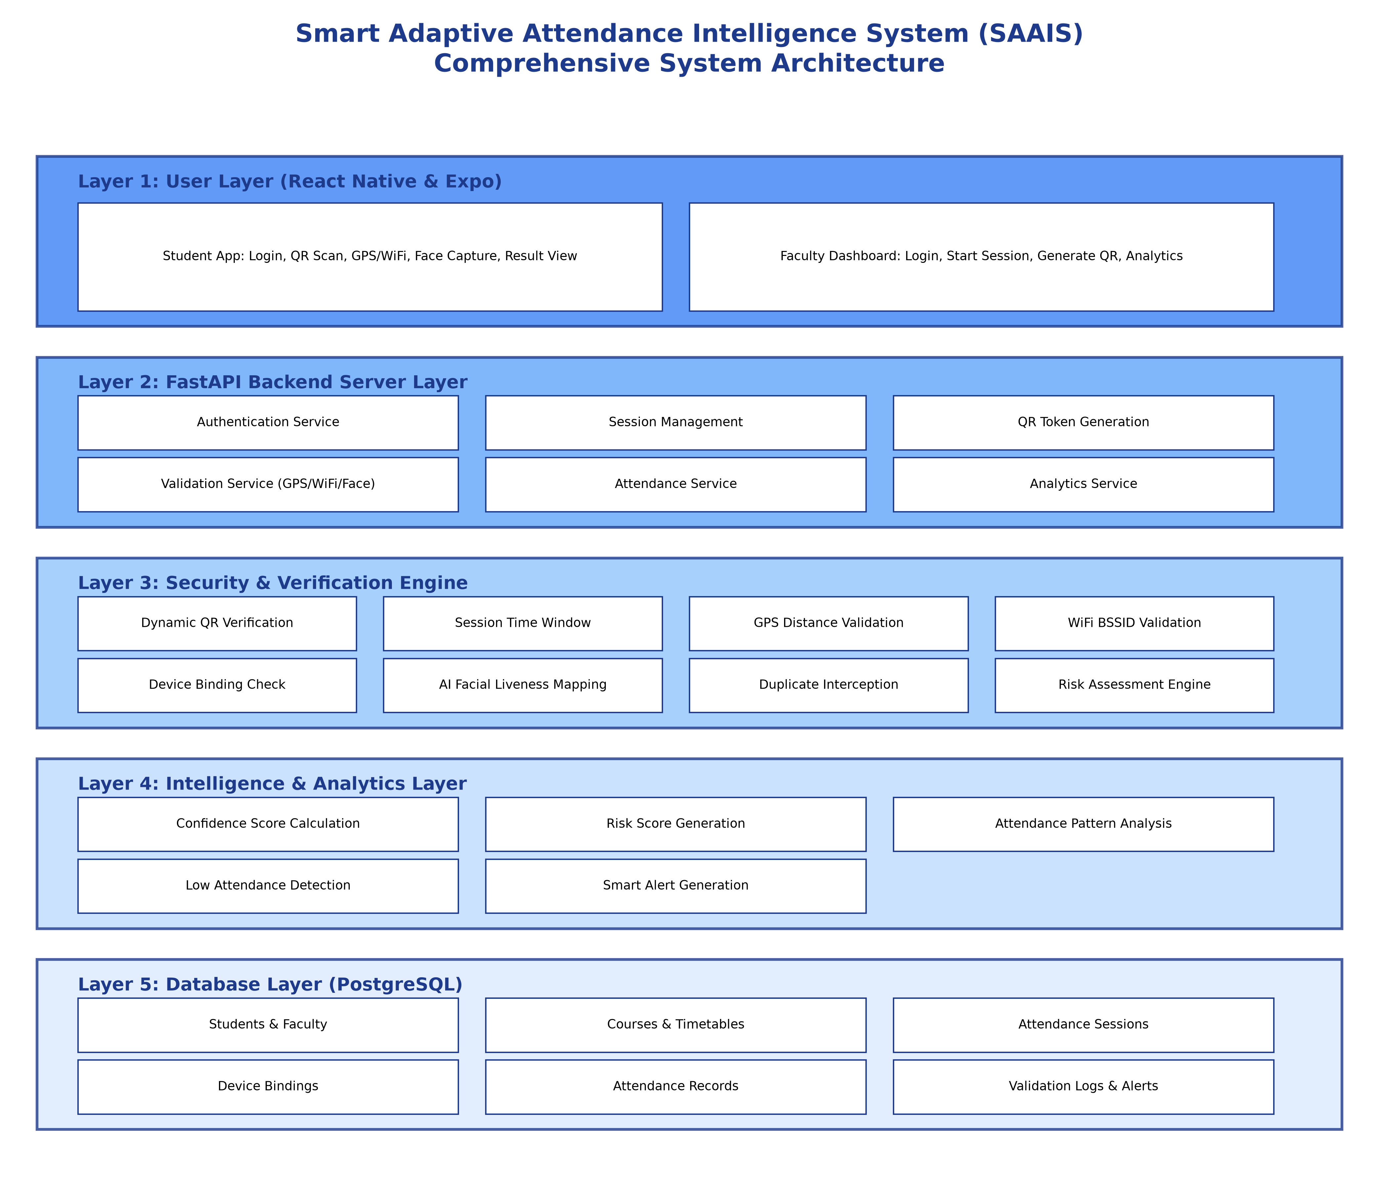
ARCHITECTURE

Slide 12
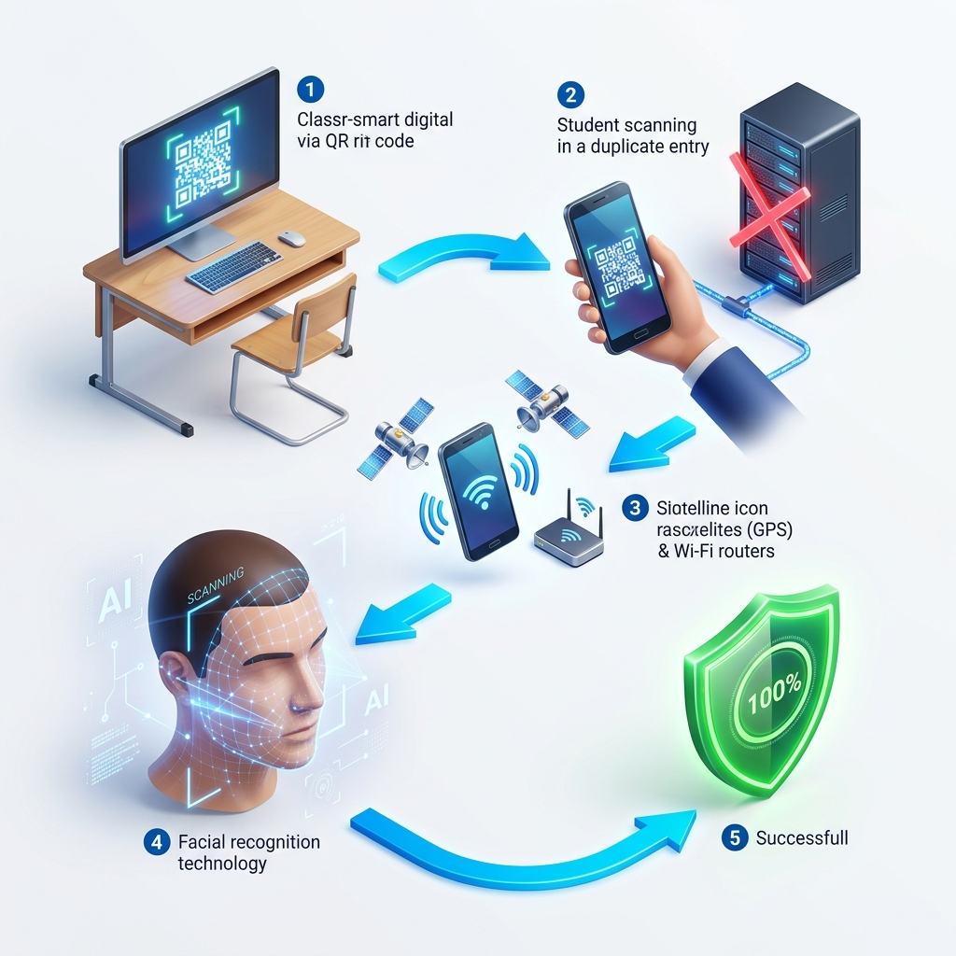
Working Methodology

Slide 13
Security Layers
Authentication Layer
Dynamic QR Tokens
Session Time Window
Device Binding
Presence Verification Layer
GPS Validation
Wi-Fi Validation
Context Capture
Intelligence Layer
Confidence Score
Risk Detection
Duplicate Detection
Attendance Pattern Analysis

Slide 14
Implementation
APIs
Student Login
Faculty Login
Session Management
QR Validation
Attendance Submission
Modules Developed
Student Module
Faculty Module
Verification Module
Analytics Module
Frontend
React Native
Expo
Backend
FastAPI
Database
PostgreSQL
AI & Security Core
dlib, face_recognition

Slide 15
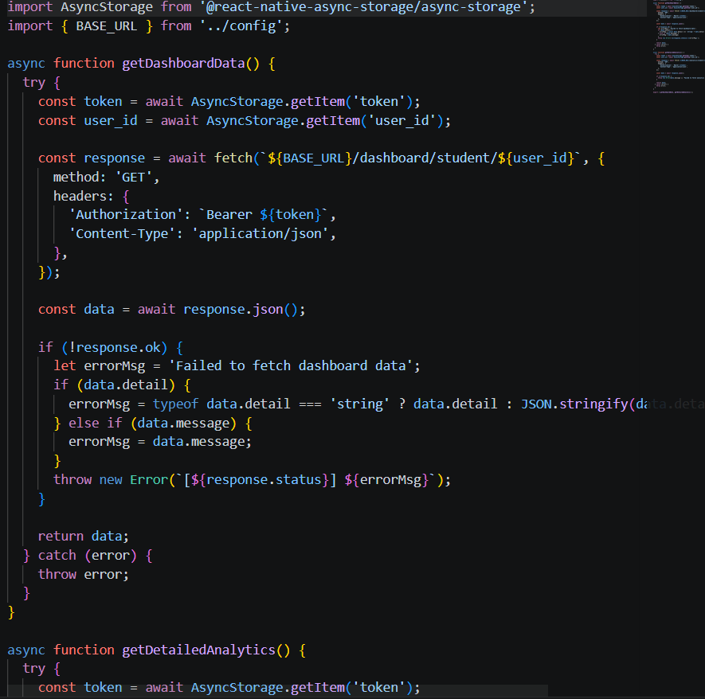
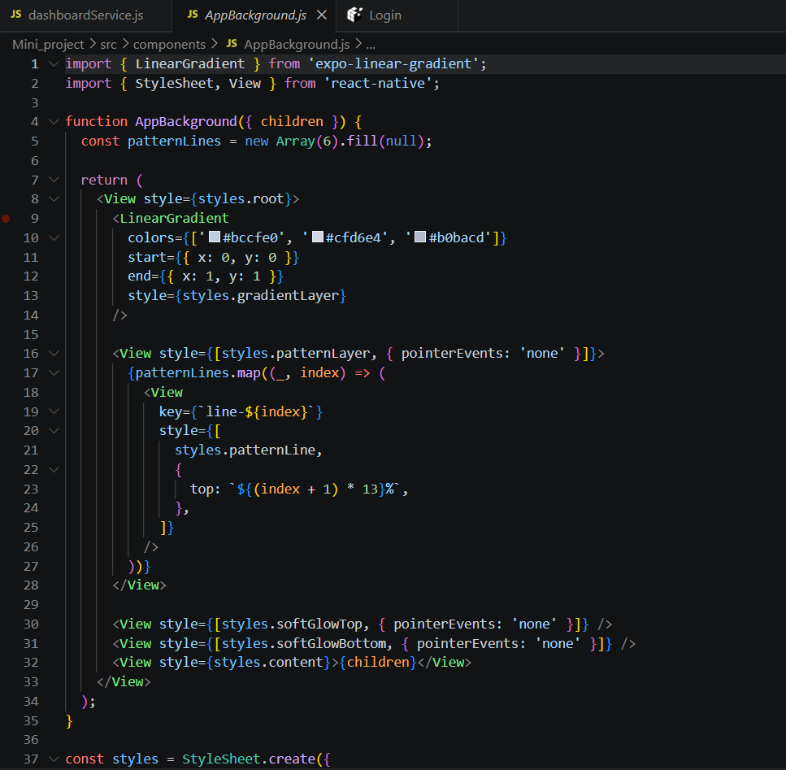
IMPLEMENTATION

Slide 16
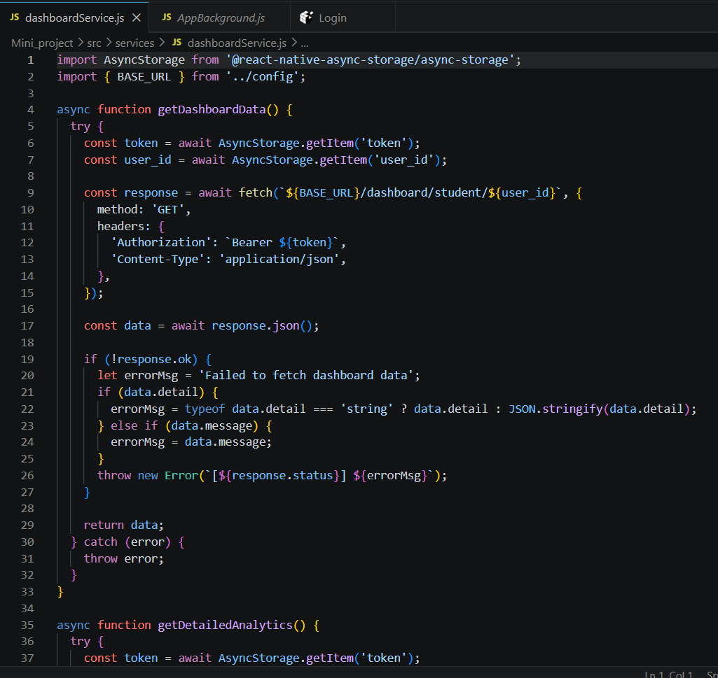

Slide 17
Result Analysis
Attendance Classification
Score | Result
80-100 | Valid
60-79 | Suspicious
Below 60 | Rejected
Outcomes
Accurate attendance marking
Reduced proxy attendance
Real-time attendance monitoring
Improved attendance insights

Slide 18

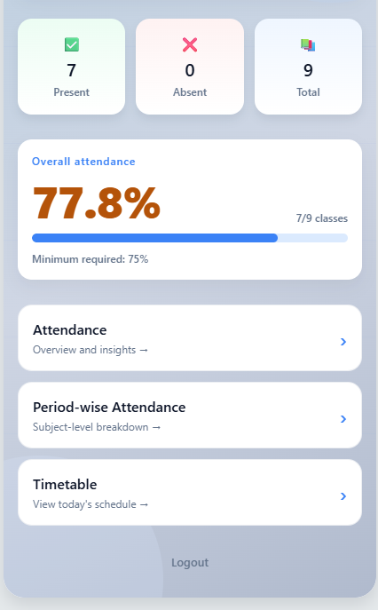
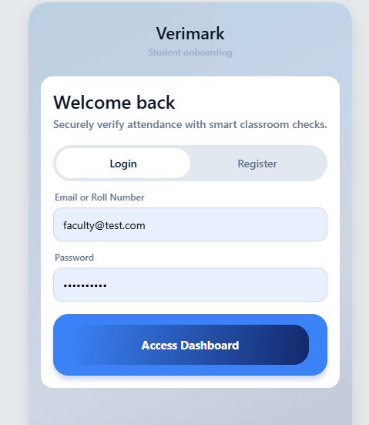
RESULT ANALYSIS Faculty Dashboard

Slide 19
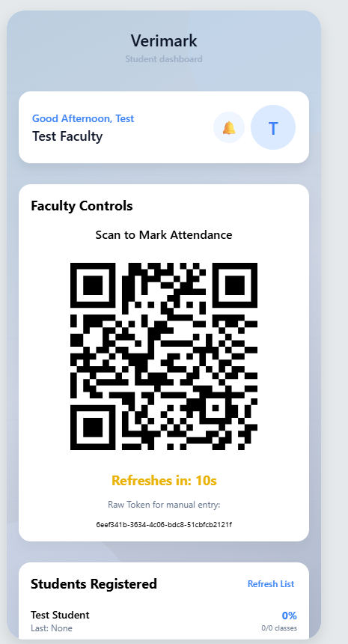
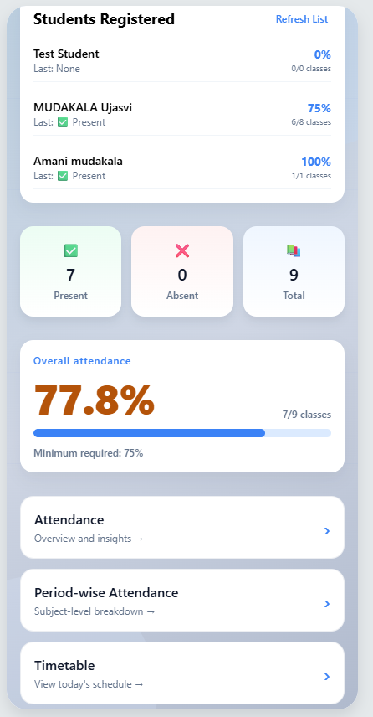
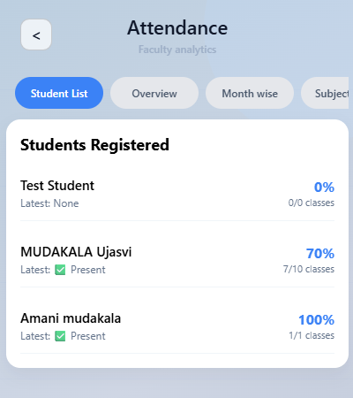

Slide 20
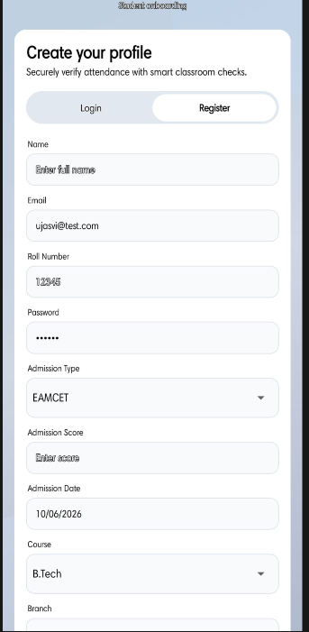
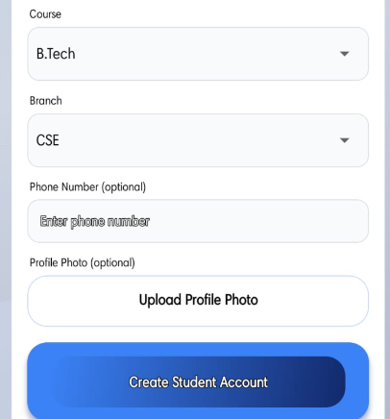
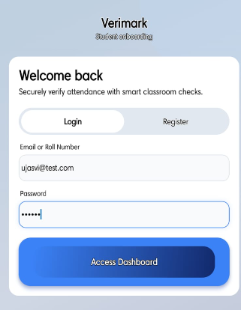
RESULT ANALYSIS Student Dashboard

Slide 21
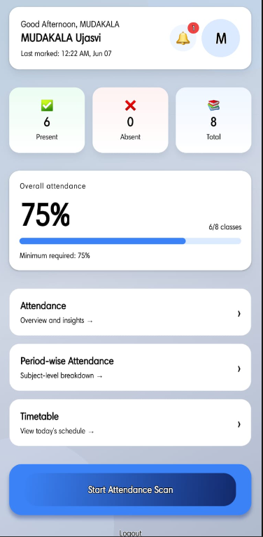
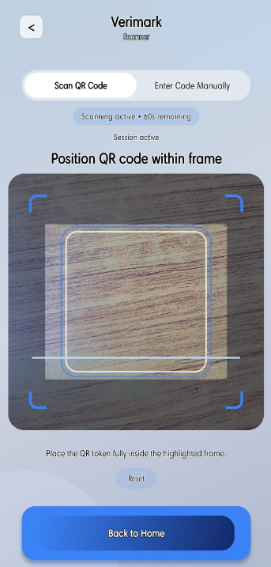
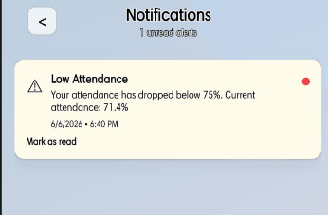

Slide 22
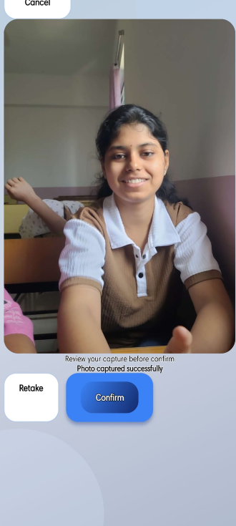
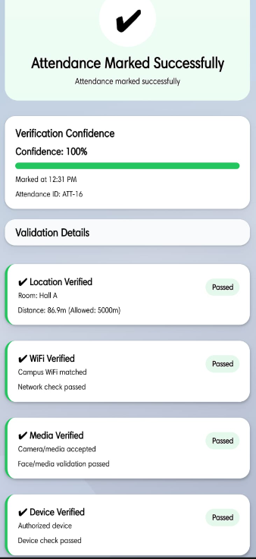
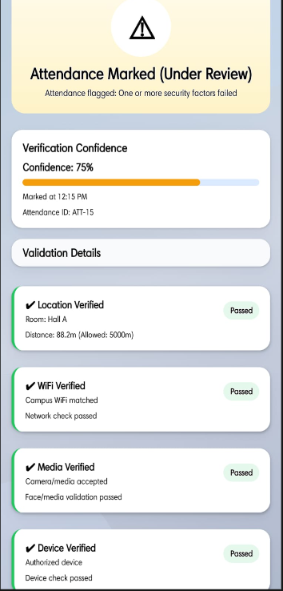
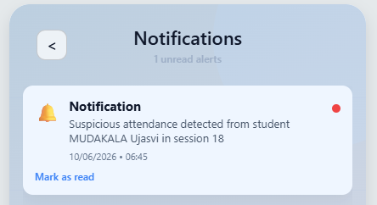

Slide 23
Advantages and Limitations
Advantages | Limitations
Eliminates proxy attendance through multi-layer verification. | Requires a stable internet connection for real-time validation.
Automates attendance recording and reduces manual work. | GPS accuracy may vary based on device and surroundings.
Provides real-time attendance monitoring for faculty. | Students must have smartphones with required permissions enabled.
Uses dynamic QR codes for enhanced security. | Wi-Fi validation depends on proper campus network setup.
Generates analytics and attendance reports automatically. | Initial deployment and configuration require technical effort.
Improves accuracy, transparency, and institutional efficiency. | Privacy concerns may arise due to location and device tracking.

Slide 24
CONCLUSION
The Smart Adaptive Attendance Intelligence System (SAAIS) provides a secure, intelligent, and efficient solution for modern attendance management in educational institutions. By integrating dynamic QR code verification, GPS location validation, Wi-Fi authentication, device binding, and contextual presence checks, the system significantly reduces proxy attendance and improves the accuracy of attendance records.
The multi-layer verification approach ensures that attendance is recorded only when students are genuinely present, while the analytics module provides valuable insights into attendance patterns and student engagement. Overall, the proposed system enhances transparency, reduces manual effort, supports data-driven decision-making, and offers a scalable solution for future smart campus environments.

Slide 25
FUTURE SCOPE
Facial Recognition Integration
AI-Based Risk Prediction
Offline Attendance Synchronization
Cloud Deployment
Biometric Verification
Cross-Institution Analytics
Mobile Notifications
Machine Learning-Based Attendance Forecasting

Slide 26
LITERATURE SURVEY
[1] S. Tabassam and M. U. Akbar, “QR Code Based Attendance Management System,” IEEE Access, vol. 9, pp. 112234–112245, 2021.
[2] A. Khanna and S. Anand, “IoT Based Smart Attendance Management System Using GPS and Wi-Fi,” IEEE Internet of Things Journal, vol. 8, no. 4, pp. 2456–2467, 2021.
[3] P. Viola and M. J. Jones, “Robust Real-Time Face Detection for Automated Attendance Systems,” IEEE Transactions on Pattern Analysis and Machine Intelligence, vol. 26, no. 2, pp. 137–154, 2022.
[4] R. Patel and D. Shah, “Machine Learning-Based Attendance Analytics and Risk Prediction in Higher Education,” IEEE Transactions on Learning Technologies, vol. 15, no. 3, pp. 345–357, 2022.
[5] N. Kumar and V. Singh, “Multi-Factor Device Authentication for Secure Mobile Attendance Systems,” IEEE Transactions on Mobile Computing, vol. 22, no. 1, pp. 89–103, 2023.
[6] Pressman, R. S., Software Engineering: A Practitioner's Approach, 8th Edition, McGraw-Hill Education, 2014.
[7] FastAPI Documentation, “FastAPI: Modern, Fast Web Framework for Python.” Available: https://fastapi.tiangolo.com/

Slide 27
[8] React Native Documentation, “React Native Framework for Cross-Platform Mobile Application Development.” Available: https://reactnative.dev/
[9] Expo Documentation, “Expo Framework for React Native Development.” Available: https://docs.expo.dev/
[10] SQLAlchemy Documentation, “SQLAlchemy Database Toolkit and ORM.” Available: https://www.sqlalchemy.org/
[11] PostgreSQL Global Development Group, “PostgreSQL Documentation.” Available: https://www.postgresql.org/docs/
[12] OpenStreetMap Foundation, “Location and Geospatial Services Documentation.” Available: https://www.openstreetmap.org/
[13] OWASP Foundation, “Mobile Application Security Verification Standard (MASVS).” Available: https://owasp.org/www-project-mobile-app-security/
[14] Haversine Formula Reference, “Great-Circle Distance Calculation.” Available: https://en.wikipedia.org/wiki/Haversine_formula
[15] JWT Documentation, “JSON Web Token Introduction.” Available: https://jwt.io/introduction

Slide 28
REFERENCES
QR-Based Attendance Systems Research Papers
GPS-Based Attendance Monitoring Research
FastAPI Documentation
PostgreSQL Documentation
React Native Documentation
IEEE Research Papers on Smart Attendance Systems
Location Verification Techniques in Mobile Systems
Machine Learning Applications in Educational Analytics

Slide 29
THANK YOU

